Slide 1
Investigate performance of sample dilution algorithms with unbalanced split error
PROJECT MEMBERS:
SAPTARSI SAHA(1451131)
RAISA BASAK(1451122)
SUCHANA BANERJEE(1451111)

Slide 2
PROJECT GOAL
To formulate the best possible algorithm to reduce the number of steps required to achieve the desired concentration of the solution.
To reduce the waste generated during the process.
To reuse the waste if possible at each step and check if the desired solution is achievable or to the nearest value at least.
To introduce positive and negative error at a given step in the DMRW AND IDMA Algorithm and check whether the deviation is critical or not.
To implement the DMRW IDMA REMIA algorithm for 2^{n} bits with error.

Slide 3
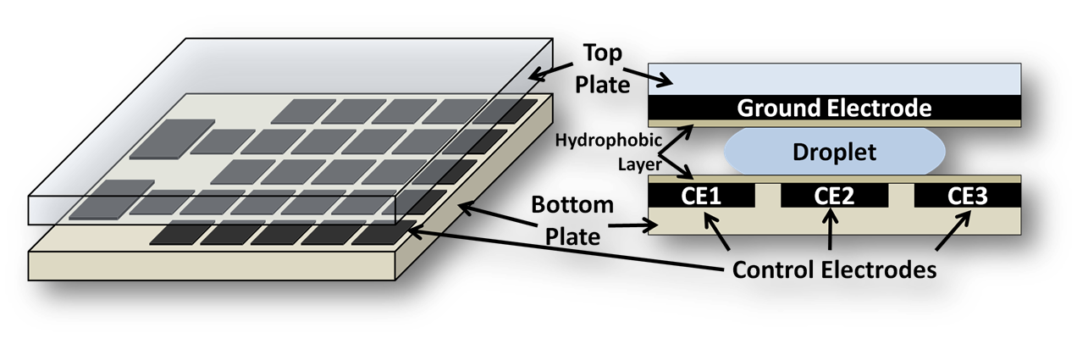
Microfluidic biochip design

Slide 4
Working of a Microfluidic Biochip
A set up consisting of electrodes with two DMF rotary mixers is put up. This technology helps in automation method. A unit cell in the array includes a pair of electrodes that acts as two parallel plates. The bottom plate contains a patterned array of individually controlled electrodes, and the top plate is coated with a continuous ground electrode. The droplet is sandwiched between the two plates and rests on a hydrophobic surface over an electrode. The droplet is moved by applying a control voltage (above a threshold voltage) to an electrode adjacent to the droplet and, at the same time, deactivating the electrode just under the droplet. This electronic method of wettability control creates interfacial tension gradients that move the droplets to the charged electrode. By varying the patterns of control voltage activation, many fluid-handling operations, such as merging, splitting, mixing, and dispensing of droplets, can be executed.

Slide 5
ANALYSIS
Obtaining the exact solution as required by the user is not always achievable.
Error while mixing the liquids are ignored.
The waste generated can be reused and reduced but cannot be completely removed from the system.
Different algorithms can be used to achieve different result at minimal possible steps but no algorithm has been developed so far that has taken error into consideration and has re-used the waste droplets in the system .

Slide 6
DILUTION AND MIXING WITH REDUCED WASTAGE(DMRW)
It starts with the two initial CFs. At every mix/split step, the algorithm requires only two CFs, called the boundary CFs, one lower and one higher than the target Ct such that the interval between the boundary CFs is minimum.
After mixing the two boundary samples at any instant of time, it checks whether the resulting CF is less or greater than Ct.
In former case the current sample is mixed with the sample having the smallest CF greater than it and in the latter case, it is mixed with the largest CF sample smaller than it.
In this process, the resulting CF approaches further toward Ct and the process is repeated systematically.
In the ﬁrst case, the lower boundary of CF is changed to the current CF keeping the higher boundary CF same as the previous one.
In the second case, where the current concentration is greater than Ct, the higher boundary CF is changes to the current CF keeping the lower boundary CF same as the previous one.
This mix/split process continues until the target concentration Ct reaches.

Slide 7
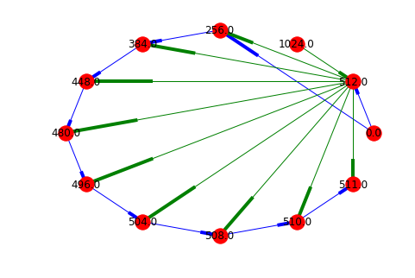
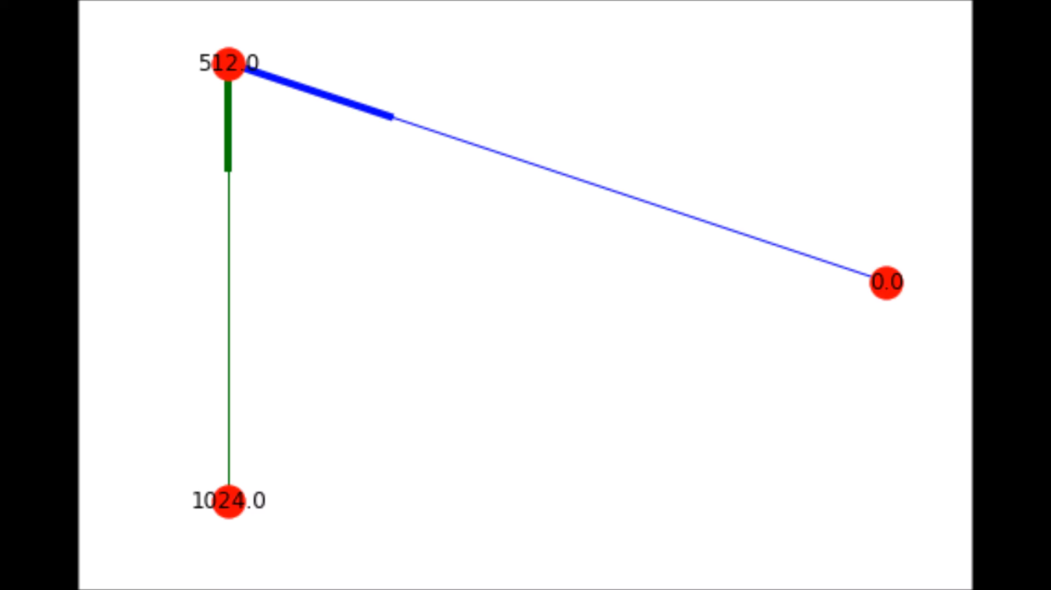
DMRW Digraphs

Slide 8
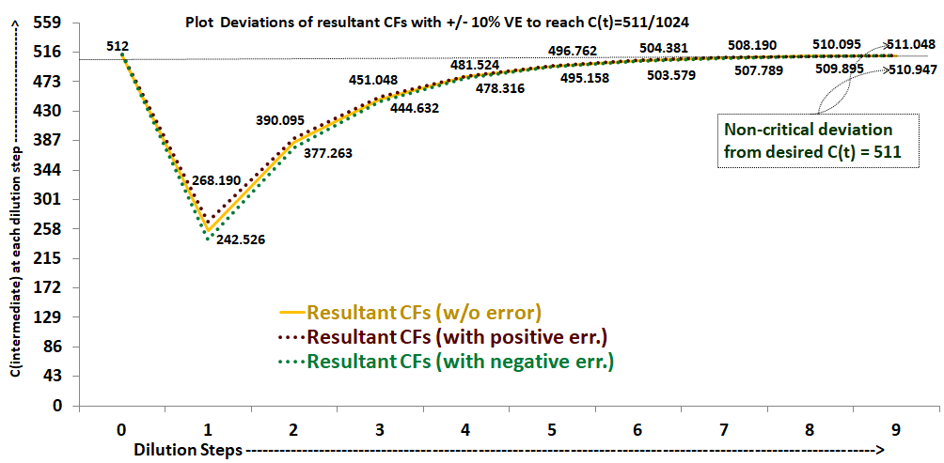
DMRW Deviation Plot.

Slide 9
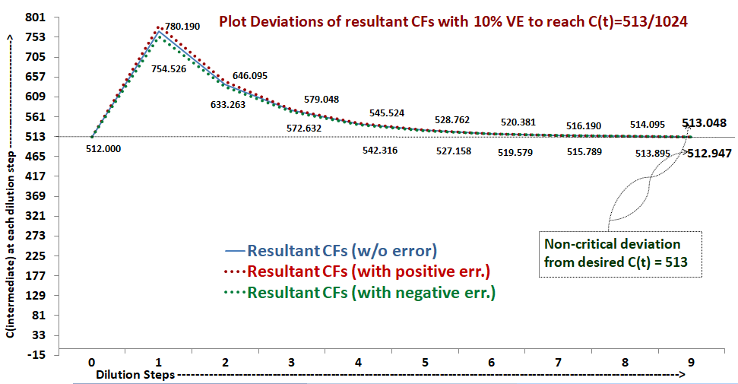
DMRW Deviation Plot

Slide 10
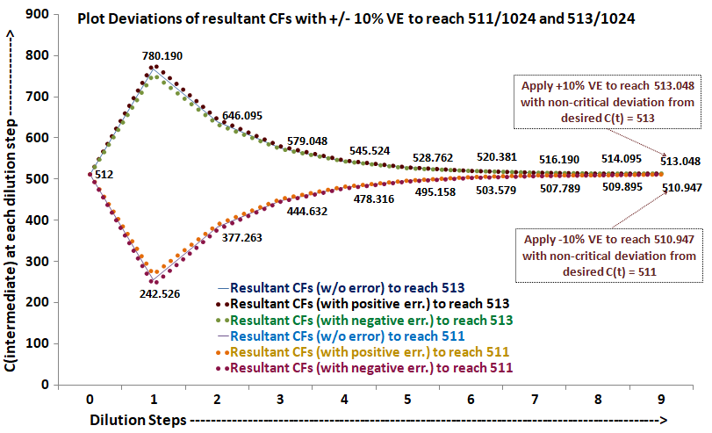
DMRW Deviation Plot

Slide 11
IMPROVED DILUTION AND MIXING ALGORITHM
Digital microfluidic (DMF) biochips offer a versatile platform for implementing several laboratory based biochemical protocols. These tiny chips can electrically control the dynamics of nanoliter volume of discrete droplets on an electrode array with desired actuation patterns. One important step in biochemical sample preparation is dilution, where the objective is to prepare a fluid with a desired concentration factor. On-chip dilution of a sample on a DMF biochip involves several mix-split steps, which often suffer from the inaccuracies caused by un-balanced splitting of microfluidic droplets. Volume error minimization is essential because of the limited availability of the stock solutions and costly reagents. We propose to analyze and enhance the performance of balanced (1 : 1) dilution/mixing algorithm, e.g. IDMA (Roy et al., 2011) in the presence of volumetric errors that may occur during the droplet splitting process. Our analysis exposes many interesting error behaviors and indicates possible solutions to correct them in a cyber-physical microfluidic platform.

Slide 12
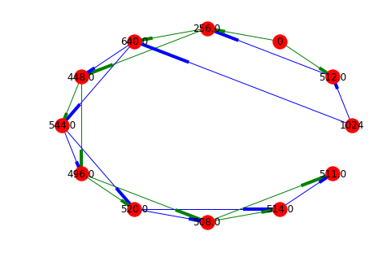
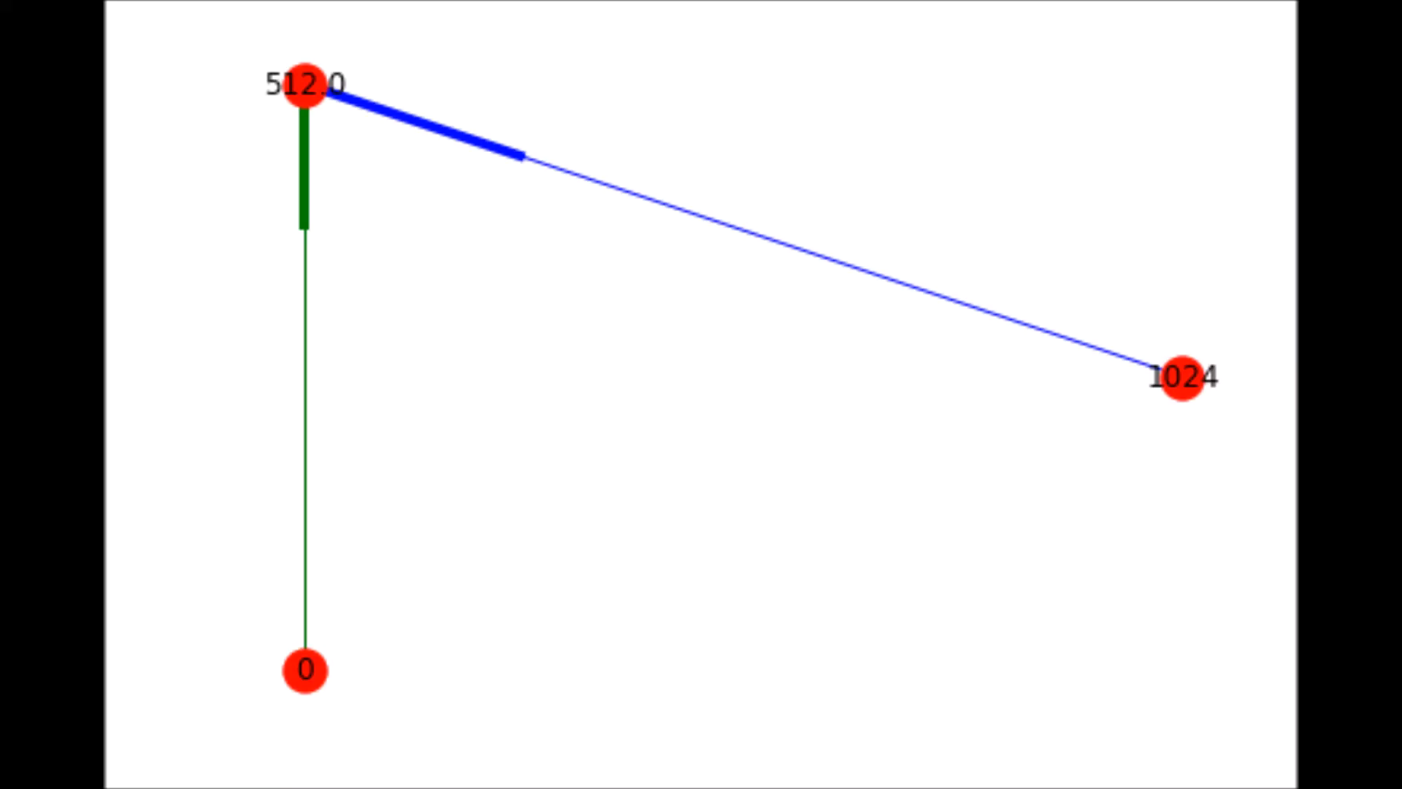
IDMA Digraphs

Slide 13
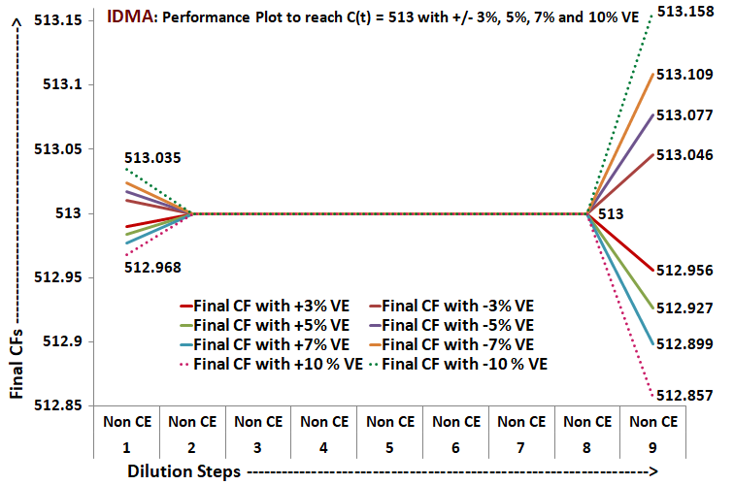
IDMA Readings

Slide 14
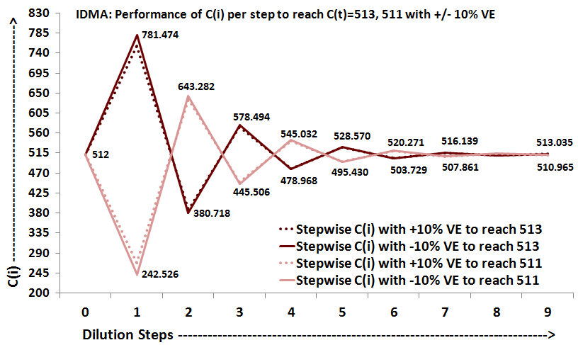
IDMA Deviation Plot

Slide 15
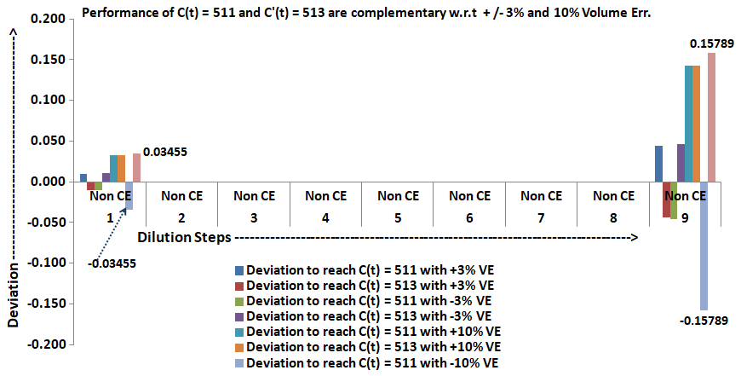
IDMA Readings

Slide 16
REMIA
Sample preparation is an indispensable process to biochemical reactions. Original reactants are usually diluted to the solutions with desirable concentrations. Since the reactants, like infant’s blood, DNA evidence collected from a crime scene, or costly reagents, are extremely valuable, the usage of reactant must be minimized in the sample preparation process. In this paper, we propose the first reactant minimization approach, REMIA, during sample preparation on digital microfluidic biochips (DMFBs). Given a target concentration, REMIA constructs a skewed mixing tree to guide the sample preparation process for reactant minimization. Experimental results demonstrate that REMIA can save about 31%~52% of reactant usage on average compared with three existing sample preparation methods. Besides, REMIA can be extended to tackle the sample preparation problem with multiple target concentrations, and the extended version also successfully decreases the reactant usage further.

Slide 17
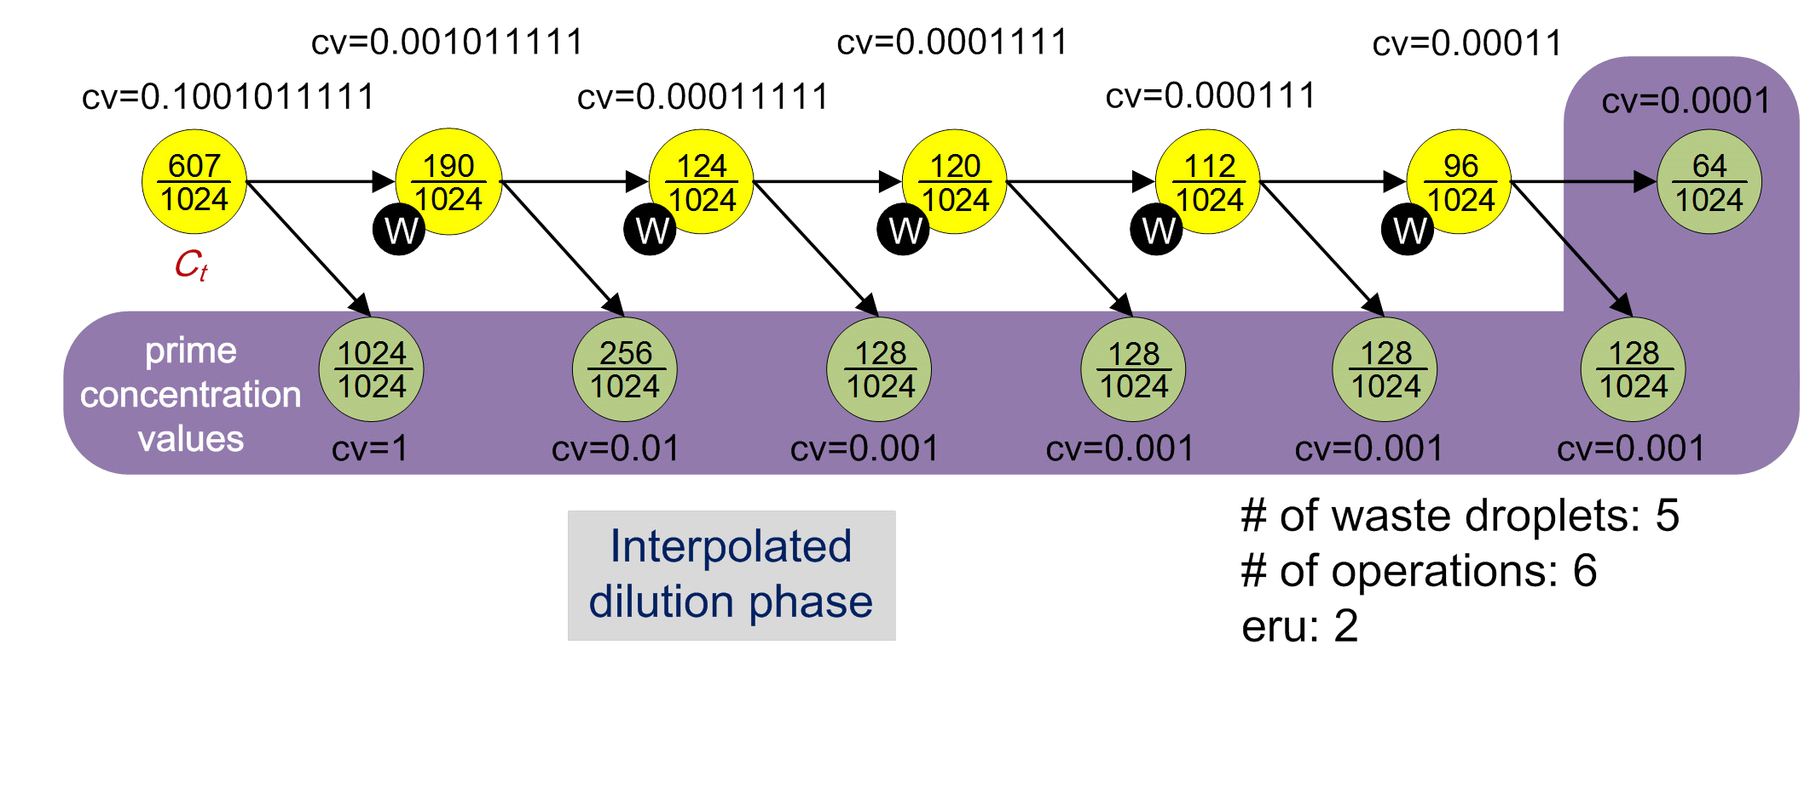
Remia Working:

Slide 18
DMRW vs IDMA vs REMIA

Slide 19
DMRW vs IDMA vs REMIA

Slide 20
DMRW vs IDMA vs REMIA

Slide 21
Conclusion
Sample preparation is an essential process to biochemical reactions. Several previous works (DMRW, IDMA) have been proposed for waste minimization. However, in our opinion, a reactant (either sample or expensive reagent) can be extremely valuable, and thus its usage should be minimized in the dilution process. We have presented reactant minimization, REMIA, for DMFBs. In our work we have carried out extensive analysis and investigation on how to apply unbalanced mix-split errors (also known as volume error) to (1:1) sample dilution steps in the reaction path on a DMFB. We have utilised the well known sample dilution algorithms like BS, DMRW, IDMA and REMIA. We have checked how the volume errors are affecting the generation of droplets at the final state when the dilution reached the desired target concentration. We aim to check if the final target CF value is beyond the acceptable limit. If true, then the measures taken to produce targets within the acceptable range. We also performed experiments to observe behaviours of a particular target CF and its complement. This analysis led us to ascertain that ubiquitous volumetric errors can be handled dynamically running sample dilution procedures. In our future work, we tend to move forward with volume error control scheme to find out if these pervasive errors can be optimized like other parameters (waste, sample, buffer, steps, intermediate storage).

Slide 22
Site Links
https://sites.google.com/view/projectcs-794-dmrw/home
https://sites.google.com/view/projectcs-794-idma/home

